Slide 1


PYTHON ASSIGNMENT
On IPL Dataset for the year 2008 to 2022

Slide 2
1. Abstract:
Indian Premier League which is also known as IPL is been a gift to cricket enthusiast and is among the most famous T20 cricket league with players coming from worldwide. IPL is hosted by BCCI(Board of Control for Cricket in India) during the summer time. What makes this series more competitive every year is the drama with every ball and hence this dataset is a complete dataset showing match information and also data for each delivery. Indian Premier League (IPL) is the most popular sports event in India with huge amount of cash flow on and off the pitch. As IPL gains more popularity, it attracts more endorsement for each team. So, prediction of a match result is very much important for the sponsors as it will help them to put their investment in good hands. In this study we build a Statistical model by which it has been shown that for a particular team, best winning strategy is, batting first, scoring as many run as possible with a very good strike rate and a very good attacking bowling. The dataset contains 2 separate files IPLMatches2008_2022.csv which contains information about Venue of the match in which city the match was played, Toss Decision, Winning mode ,Match Winner, Man of the Match, Squads and IPLMatches2008_2022.csv has information like Batsman on strike, Bowler, Extras, Runs, Wicket Ball, Date at which the match was held. When it comes to analysis part we can do a statistical test to predict the match winning team with the help of factors supporting the outcome. So with this we have proceeded with various libraries like Pandas, NumPy for doing mathematical operation and used few visualization libraries like Seaborn and matplotlib for plotting graphs, SciPy library for performing statistical test. For the analysis part we have implemented Chi Square test for finding out the factors.
2. Motivation:
Everyone will be curious about which team has the potential win the match and for this we need to find few supporting factors. So the motto for picking up this dataset is to generate some interesting statistical analysis between 2 teams and players and also to create a comparison charts so that we will perceive more insights about a team and a player.

Slide 3
3. Dataset :
The file IPLMatches2008_2022.csv contains all details of the match: Venue of the match, Toss Decision, Match Winer, Man of the Match, Squads, etc and contains the summary of each match for IPL 2008-2022 The matches are sorted from 2022 to 2008.
The file IPLBallbyBall2008_2022.csv contains ball by ball data of each and every match: Batsman on strike, Bowler, Extras, Runs, Wicket Ball, etc and contains data for each ball for the entire tournament from 2008 to 2022. The data will be updated every day until the season's final match. The match ID is given by ESPNCricinfo.
Dataset link: https://www.kaggle.com/datasets/vora1011/ipl-2022-match-dataset
4. Data Preparation:
When it comes to Exploratory data analysis part the 2 datasets have been analysed properly in order to support the outcome. So for this I have checked whether the dataset has any null values in columns and any duplicate elements are repeated. So starting first the dataset has been imported into the Jupyter notebook software with the help of Pandas library. At first when analysed the data, it has been found that dataset had many NA values with respect to the context but here I have done the renaming so that dataset doesn’t read it as NaN value. Also few of the teams are represented with 2 names and for this I have renamed with the updated names.

Slide 4
5. Research Question:
1) As mentioned in the previous slides the main aim for exploring the dataset is to find out the Winning team with the help of factors listed below:
What is the percentage of wins of each team?
Which venue results in a win for Batting first team and vice versa?
Who is the most consistent batsman and bowler in each team and also in the entire league?
Who wins the most player of the matches in the tournament?
Who scored more runs, took more wickets and head to head records between teams and players?
2) For the Proof of concept we will be doing Hypothesis testing in order to compare with the original results.

Slide 5
6 A). Methodology:
Before jumping directly into the analysis part it is important to understand Team strategies with that it helps a team to find way for win.
Firstly I have generated the statistical analysis of
(i)Individual player performance with respect to batting and bowling department, which includes
a)Overall top Run getters and Wicket tackers
b)Who conceded more DOT balls. (gets the economy data)
c)How many boundaries and Sixes a player has hit so far.
d)Who won the most man of the match awards.
(ii) Head to Head data amongst 2 players and 2 teams.
a) Which batsman finds easier for hitting fours and sixes against which bowler.
b)How many times a team reached Knockout stages.
c) Which all batsman are prone to get 'OUT' against a particular bowler.
d)find overall winning percentage of a team to determine the consistency.
(iii)Venues favouring a team:
a)How many times a particular team has won/lost in a specific Venue.
(iv)Toss winning factor
a)Checking how many times a team have won the toss and win/lost the match as well and vice versa.

Slide 6
6 B). Methodology:
The previous slide is considered as observed set of values which generates data based on original information.
Since the dataset is having more than 2 categorical variables it is impossible to apply a direct correlation analysis within factors.
As a cricket domain expert predicting a win for a team relies mostly on few factors like
Winning a toss to decide whether to bat or bowl first or vice versa.
Playing a match in a particular venue that can favour a team for a win.
With the above 2 factors it’s time to compute Chi Square Test which is one of the hypothesis testing
The Main aim is to find whether there are any contributing factors for the Win/Lose based on:
Winning or losing Toss
Playing in Home and Away venues
So the Statistical model used is Chi Square test(which works on categorical variables)
Steps for analysing the Chi Square test: [1]
a) We would start by setting hypothesis
H0 — There is no relationship between Toss Decision and Win/Lose a match
H1 — There is relationship between Toss Decision and Win/Lose a match

Slide 7
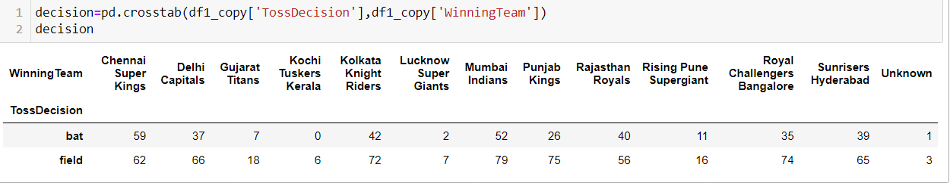
b) Preparing contingency table or frequency count table using crosstab function of Pandas library from the existing data
We also call it as observed values
For example in our dataset we have used Toss Decision while winning a toss and Winning team.
c) Expected Values Calculation
Now we recreate above table with expected values. This is a very important step as one should understand how we are arriving at the expected values.
For calculating lets apply probability concept: P(A and B) = P(A) * P(B)}
d)Calculating Chi Square Statistic
The chi-square statistic compares the size of any discrepancies between the expected results and the actual results, given the size of the sample and the number of variables in the relationship.
e)Calculating Critical value
A chi-square critical value is a threshold for statistical significance for certain hypothesis tests and defines confidence intervals for certain parameters. Chi-square critical values are calculated from chi-square distributions.

Slide 8
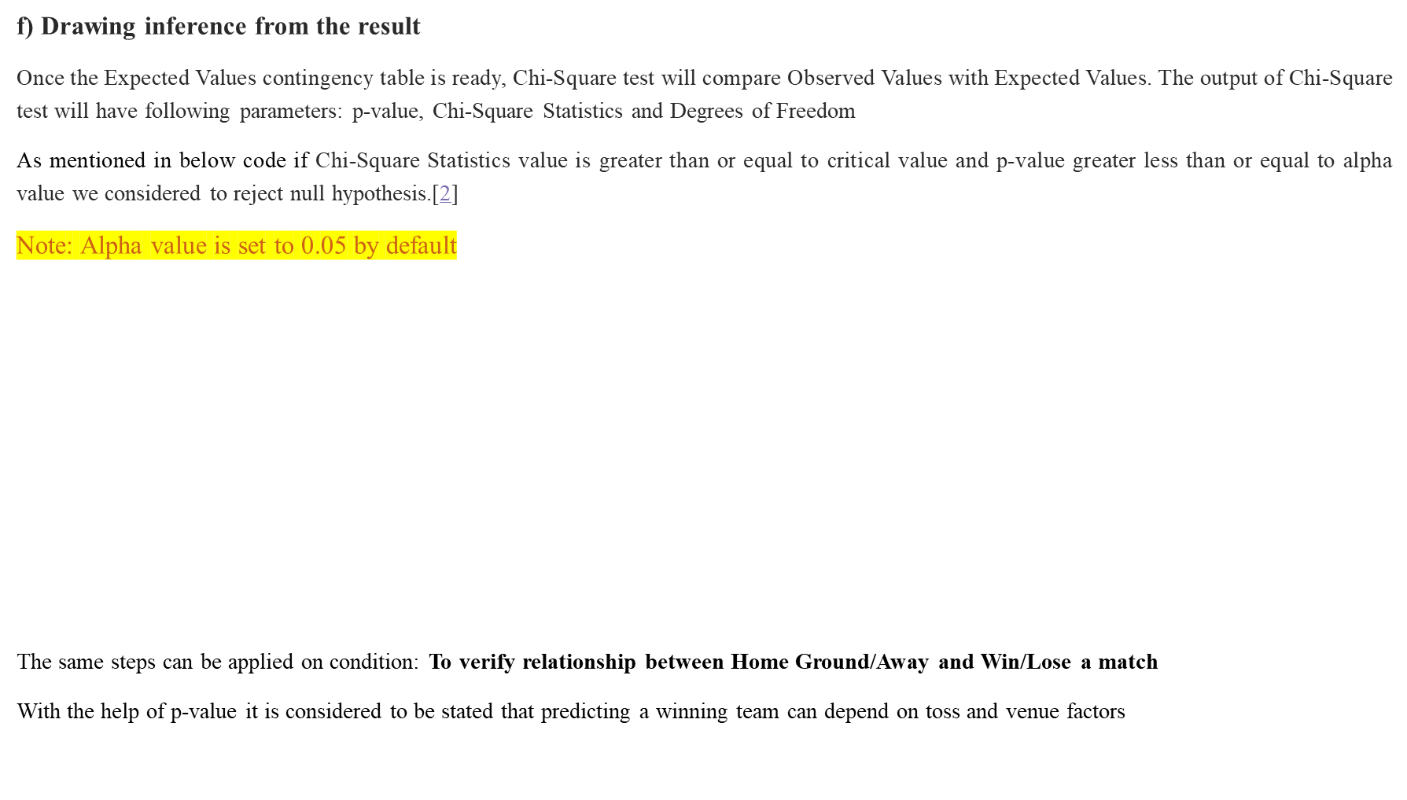
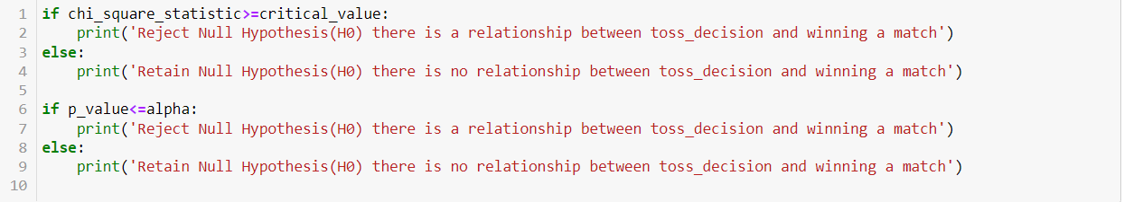

Slide 9
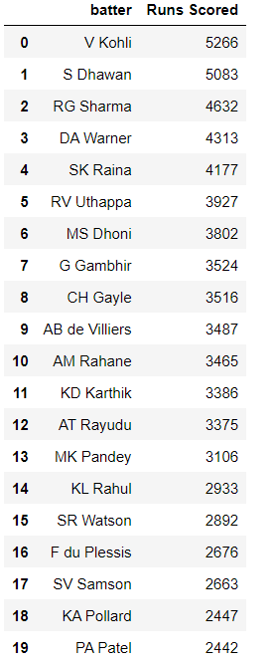
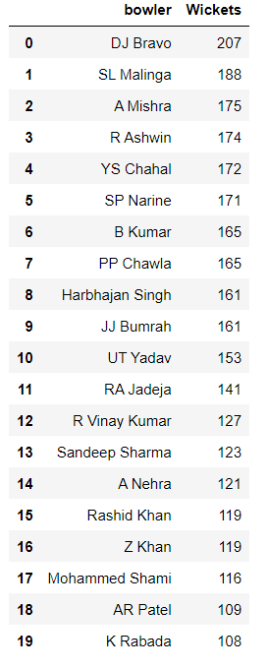
7 A) Findings:
As discussed in previous slides its time to check the analysis in the form of tables and graphs.
(i)Individual player performance with respect to batting and bowling department, which includes
A)Overall top Run getters and Wicket tackers (Top 20)

Slide 10
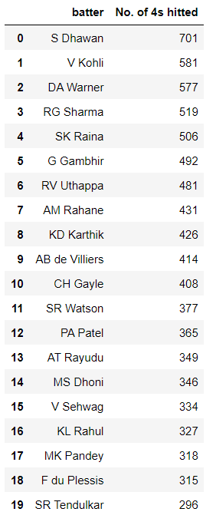
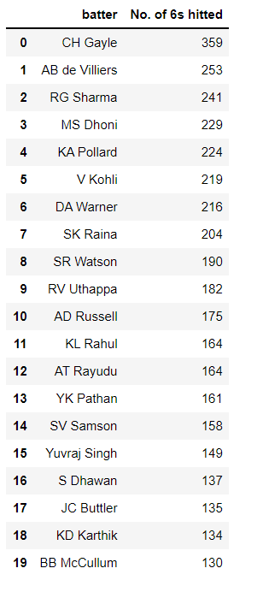
B) Which batsman has hitted more 4's and 6's (Top 20)
4 counts
6 counts

Slide 11
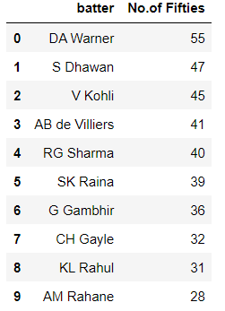
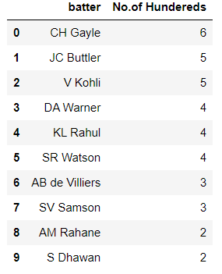
C) Lets check how many times a player has smashed most Centuries (>100 runs in each match) and Half Centuries (>=50 and <100 runs in each match) (Top10)
Half Centuries:
Centuries
Observation:
1. The previous and current slides shows how persistent a batsman is and this helps to secure more runs for a team

Slide 12
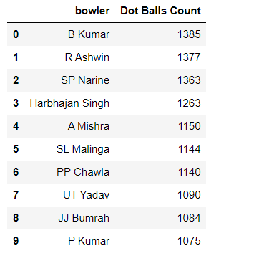
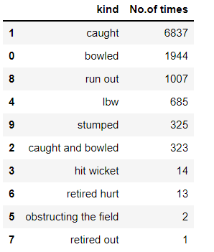
LETS CHECK WHICH BOWLER HAS CONCEDED MOST DOT BALLS (TOP 10)
Ob Observation:
When a bowler considers more DOT balls it is considered as best economy bowler he can be.
NOW LET US SEE MOST COMMON DISMISSAL TYPES
Observation:
As the most common dismissal kind is from CAUGHT batters need to be careful while picking up the shots.

Slide 13
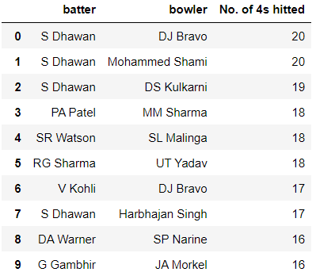
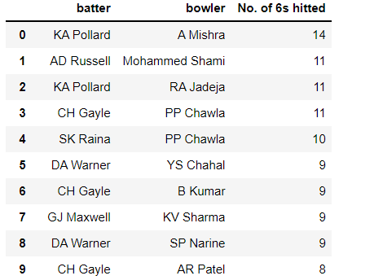
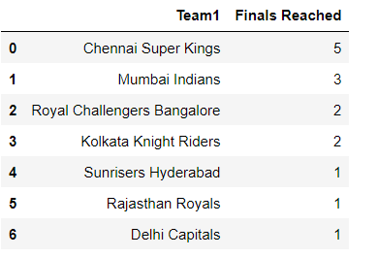
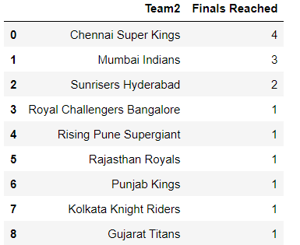
(II) HEAD TO HEAD DATA AMONGST 2 PLAYERS AND 2 TEAMS.
a) Which batsman finds easier for hitting fours and sixes against which bowler. (Top 10)
b) How many times a team reached Knockout stages.
Team 1: Team2:

Slide 14
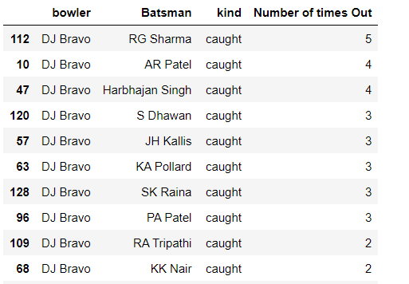
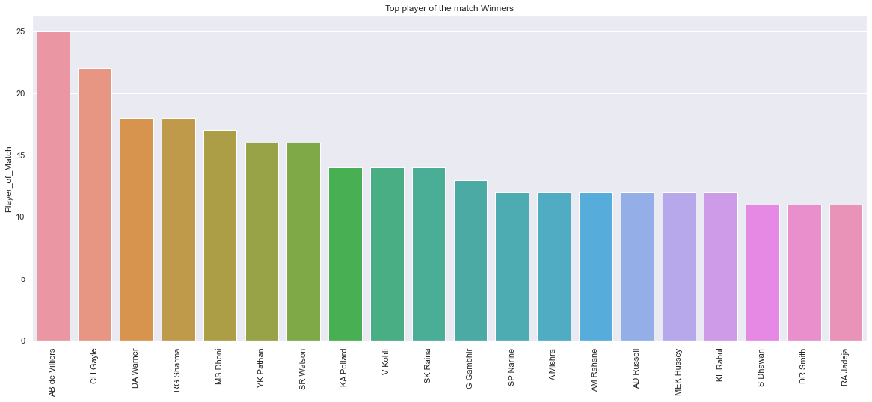
c) Which all batsman are prone to get 'OUT' against a particular bowler.
(i)As there many bowlers were involved lets take leading wicket taker DJ Bravo for analysis. (Top 10)
Observation:
(i)Rohit Sharma got out by caught against DJ Bravo's spell for 5 times and the kind of out is caught.
d ) Top player of the match Winners
Observation:
(i)AB De Villiers has received the top most man of the match awards with maximum of 24
(ii)Also note man of the match award goes to the game changing player i.e. taking the match into his hands
or resurging from a worst position to a winning position.

Slide 15
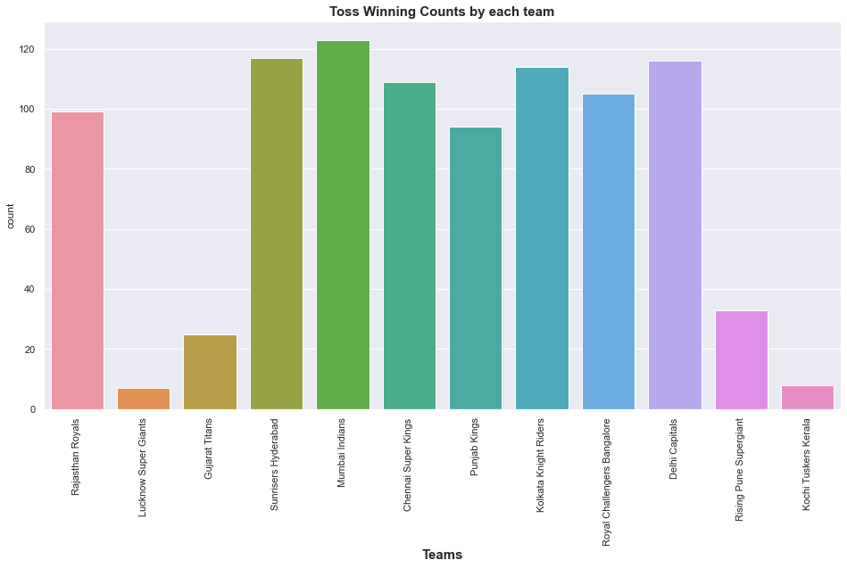
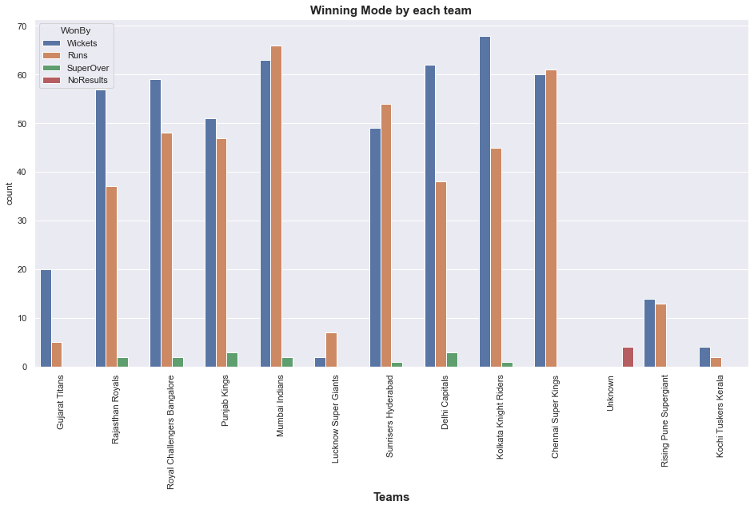


7 B) Findings
Checking how many times a team have won the toss and win/lost the match (ii) Winning Mode by each team
Observation:
From the observed statistics team winning the toss at the start of the match are prune to win the match mostly.
For example Mumbai won most of the tosses and won the match as well.

Slide 16
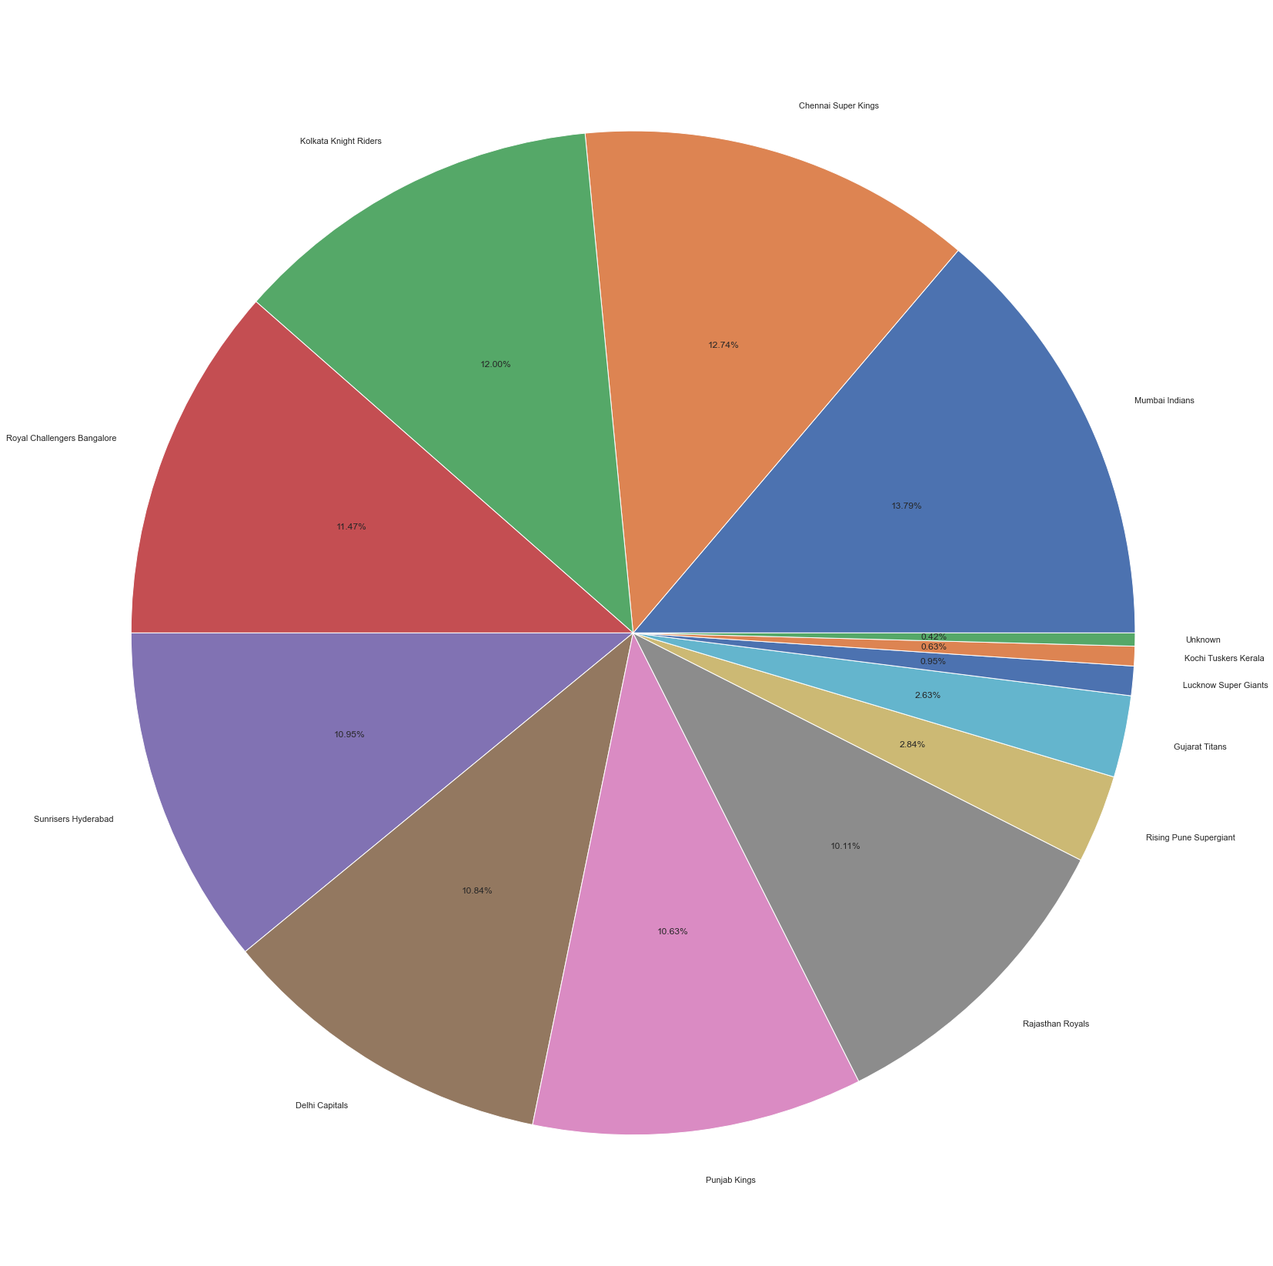
In Order To Confirm Further Lets Check The Winning Percentage By Each Team
Observation:
From the fact it is clear that Mumbai Indians has highest percentage wins with 13.79% and stands at the top.

Slide 17

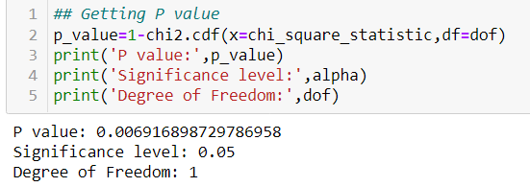
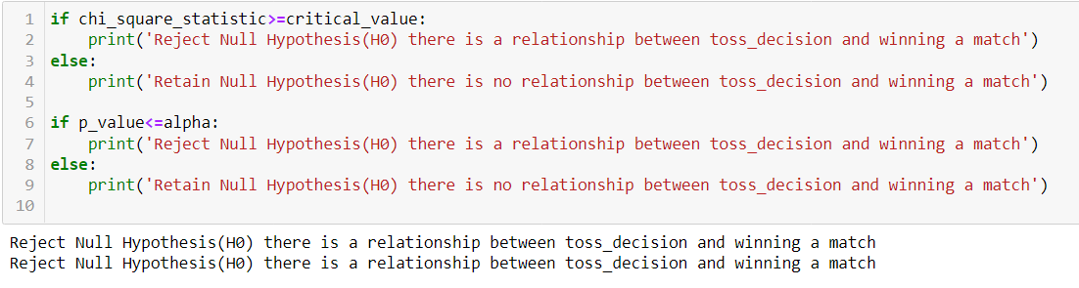
Lets Prove This By conducting Hypothesis Testing By Using Chi Square Test
After explaining in the previous slide 7 and 8 after doing statistical analysis using chi square below results were found
Observation:
Even after conducting Chi square test it is showing that there is a correlation between winning the toss and winning team.

Slide 18
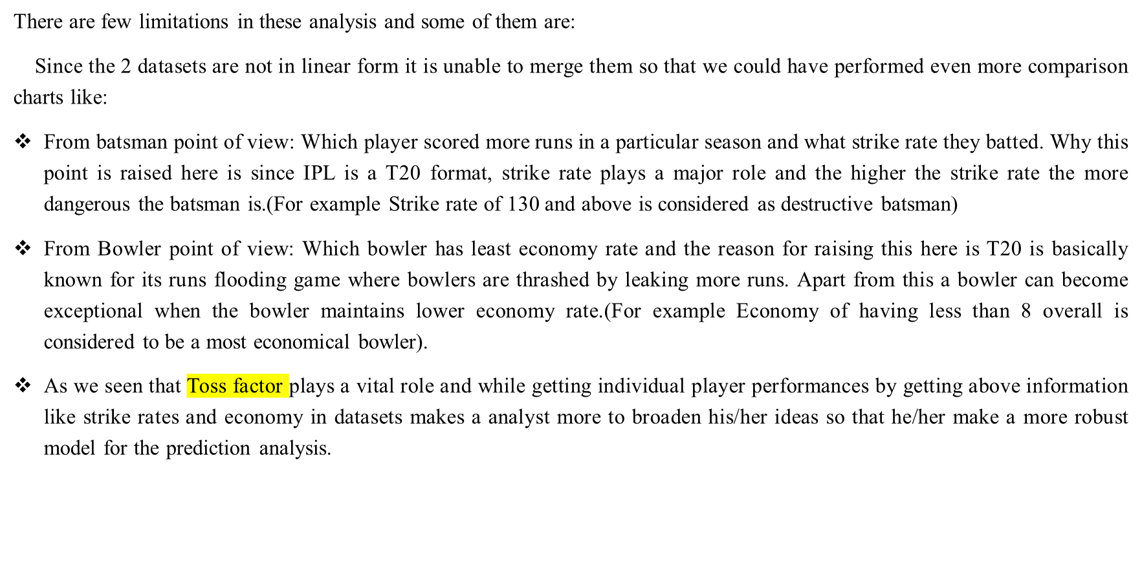
8. Limitations

Slide 19
9. Conclusions:
From the evidences collected we are able to conclude that for a winning a match involves several conditions and majority deals like Toss Winning Factor, Venue of a ground.
Lets summarize the analysis down below:
Virat Kohli has scored the maximum runs and DJ Bravo took maximum wickets in the IPL which gives us a assumption like they are considered as most consistent athletics. Adding to this head to head records between a bowler and batsman are included as well. This gives an overview on how they react between each other.
Batsman like Chris Gayle, David Warner are considered to be more dangerous as they keep on striking the ball either 4 or 6 runs so that runs on the scoreboard gets accumulated quickly.
AB de Villiers has won most player of the match awards which tells us that he is a game changing player also termed as X-Factor player.
Mumbai Indians has won more tosses and the results has favoured their way with a maximum percentage of wins of 13.79%, and eventually won the most IPL title awards than any other teams.
A team plays in their home/or in any particular venue the probability of chances of winning a match by home team is very high.

Slide 20
10. References:
Géron, A. (2019) Hands-on machine learning with Scikit-Learn, Keras, and TensorFlow : concepts, tools, and techniques to build intelligent systems. Beijing: O'Reilly.[1]
Jain, R. (2020) Correlation between Categorical Variables. Available at: https://medium.com/@ritesh.110587/correlation-between-categorical-variables-63f6bd9bf2f7#:~:text=Chi%2DSquare%20test%20of%20independence,categorical%20variables%20is%20easily%20available. (Accessed: 04st December 2022). [2]

